Slide 1
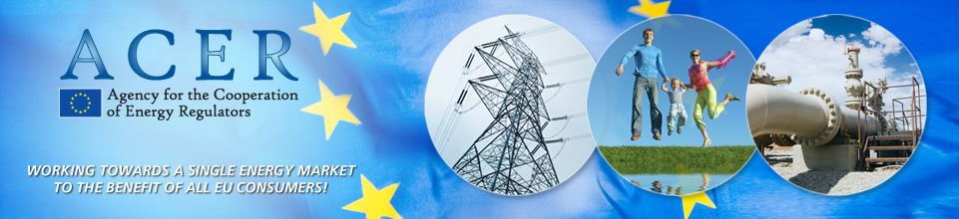



Report on 2nd Energy Infrastructure Forum
Dennis Hesseling
Head of the Gas Department
ACER
GRI SSE RCC meeting
Budapest, 7 July 2016
TITRE
The views expressed in this presentation are the views of the speaker and do not necessarily reflect the views of the Agency for the Cooperation of Energy Regulators, or of any of its Boards.

Slide 2
Outline
General impression Forum
Conclusions
ACER contribution: PCIs, CBCA

Slide 3
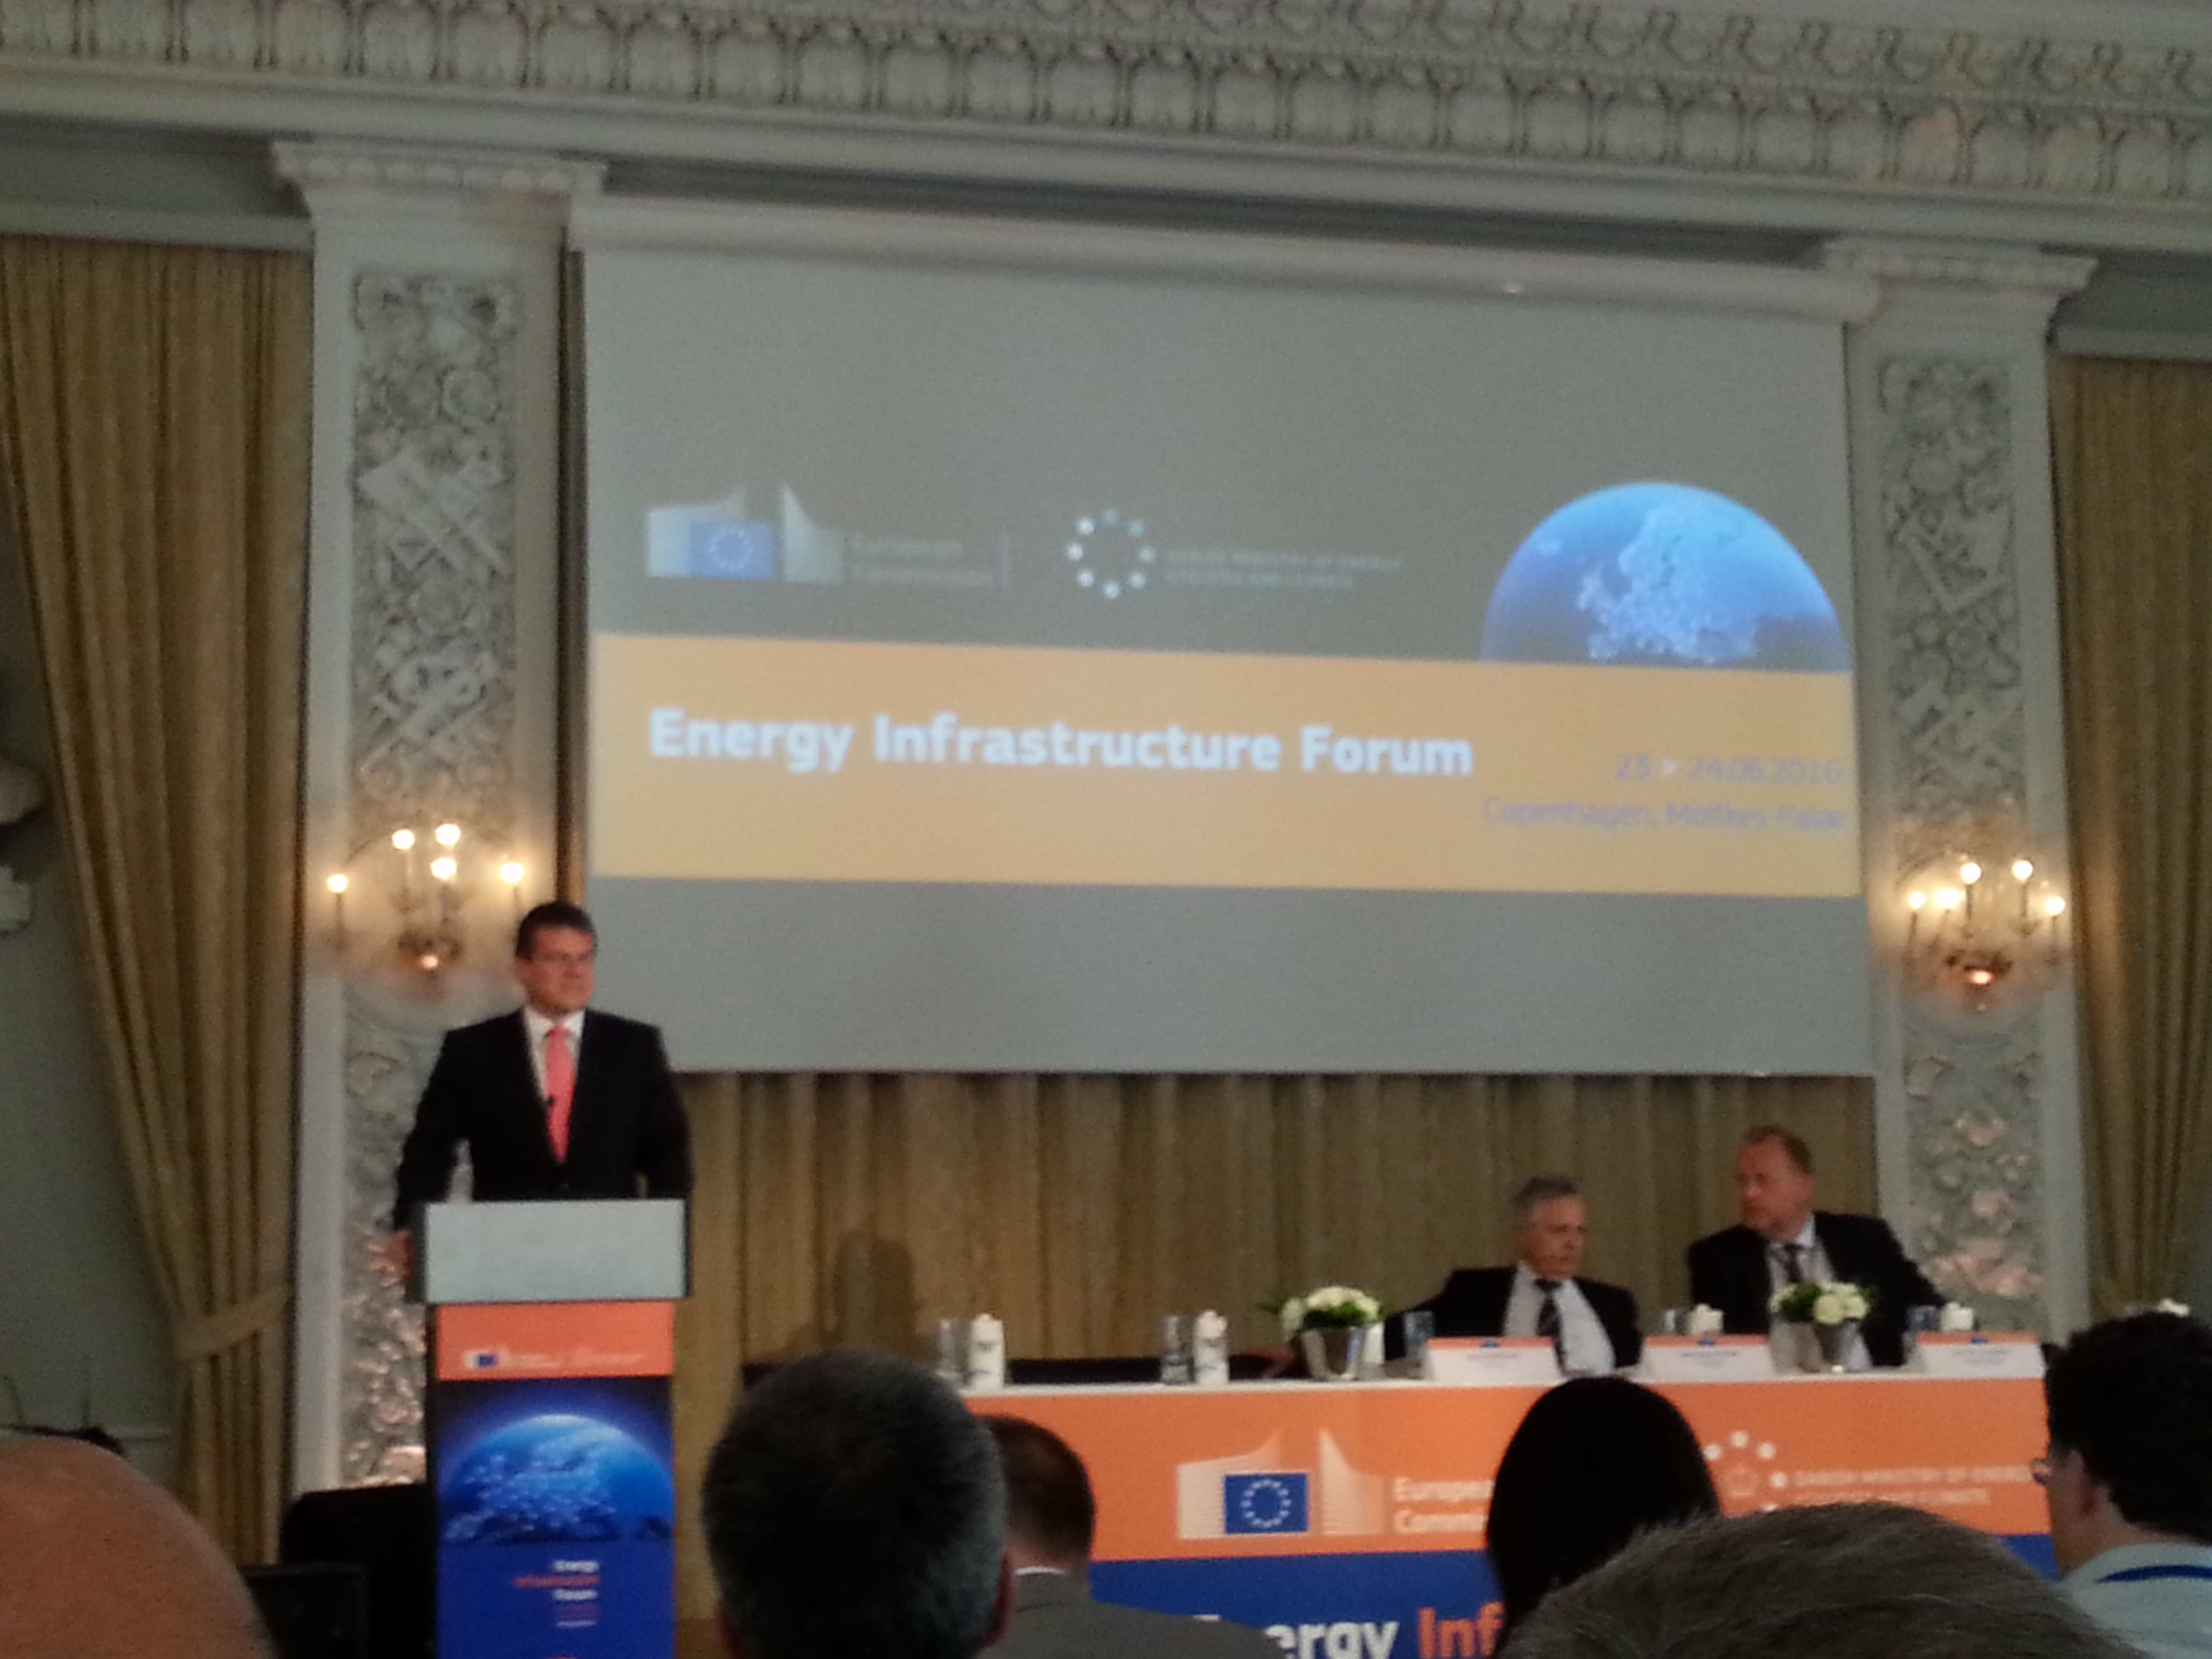

Day 1: political
Agenda and conclusions: https://ec.europa.eu/energy/en/events/energy-infrastructure-forum

Slide 4
Relevant parts conclusions (1)
Regional cooperation groups should be driven by concrete needs. An inclusive approach, involving all stakeholders (civil society, industry, etc.) is essential to effectively support the realization of PCIs
The CESEC High Level Group should work vigorously towards delivering the priority infrastructure projects and regulatory initiatives that are essential to the development of an integrated and competitive gas market in the region; it is necessary to further develop close links in infrastructure between the Energy Community, CESEC and other regional cooperation structures
the Regional Groups should use information on project progress, including on significant rescheduling or lack of advancement, as a factor in the PCI identification process

Slide 5
Relevant parts conclusions (2)
The ENTSOs should set up expert groups on implementation of transmission projects in the electricity and gas sectors respectively. The experts shall examine options relevant to each sector to support the timely implementation of infrastructure projects. They shall identify, where relevant, and implement approaches that for example can help to get more acceptance from residents, that bring value locally and that facilitate political buy-in on all levels. The expert groups shall report in writing to the participants of the Forum on their findings and the progress achieved.

Slide 6
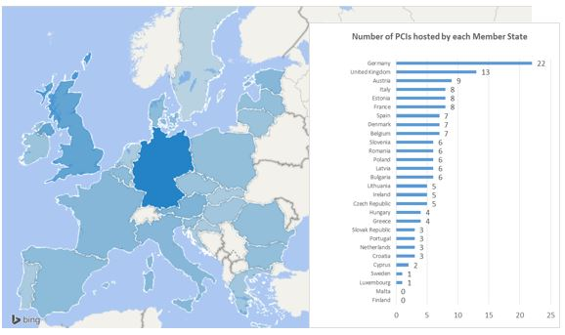
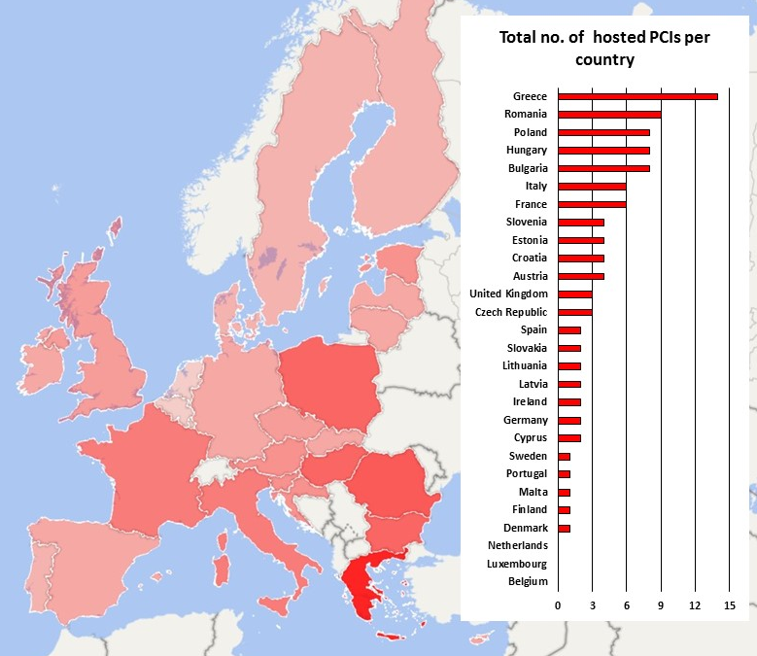
Hosting Countries PCIs
Electricity
Gas

Slide 7



Main findings (1)
Approximately half of the PCIs are on time, while half are delayed or rescheduled on each list.
Some of the PCIs have been accumulating postponement (delays or rescheduling) since 2012/2013.
For almost 1 in 4 projects
no activity was reported for 2015.
For most of the “old” PCIs
no advancement in their implementation status was reported for 2015.
Only 2 rounds of PCI monitoring have taken place so far. Some patterns and features are visible but not long-term trends (observations are available for about 3 years or less).

Slide 8
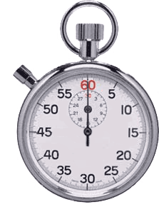


Main findings (2)
Delays usually take place in a more advanced stage (in permitting, and in gas also during construction) and rescheduling in the less advanced stages (consideration and planning phase).
Reasons for delays are diverse and project-specific. The most frequently mentioned reason is linked to permitting and licensing. Promoters expect that the 3.5 year limit of permitting duration is respected.
The most frequently reported reason for rescheduling is related to uncertainties in the project’s implementation or to priority being given by promoters to another project.

Slide 9



Main findings (3)
The total expected investment costs of all (including competing) PCIs on the 2015 PCI list:
Electricity: €52.5 billion Gas: €54 billion Total: €106.5 billion
NPV of expected life-cycle costs of all (including competing) PCIs on the 2015 PCI list:
Electricity: €10.4 billion Gas: €7.8 billion*
If all electricity and gas PCIs were implemented as currently planned, cost would be ~ €83 billion over the coming 6 years.
Actual CAPEX in 2015:
Electricity: €1.2 billion Gas: €1.5 billion Total: €2.7 billion
Expected CAPEX over the next 6 years if CAPEX spending rate is the same as in 2015:
Electricity: €7.2 billion Gas: €9 billion Total: €16.2 billion
No strong interest visible from promoters to use financial and regulatory support tools (CEF, CBCA, incentives). Existing regulatory frameworks sufficient?
*not including all PCIs, including inconsistencies in the reports

Slide 10
Progress and Challenges
PCIs are very diverse in project features and maturity
Less mature projects are often rescheduled:
  Less mature projects may be dependent on network developments (i.e., on the progress of other projects) or market developments (e.g. evolution of supply/generation or demand)
  Such instances reflect that not all PCIs would/should necessarily be built
  Assessing the degree of maturity of projects should take place at the stage of the PCI selection, so that the uncertainties around the less mature projects are identified as such (while not necessarily preventing such projects to be included on the PCI list)
Some projects do not show visible progress since 2013:
  Not necessarily a problem - lack of progress may be justified by external reasons (delays, dependence on network or market developments) or inherent reasons (large, complex projects may need more than 2-4 years to demonstrate progress, I.e. more time than the validity of a PCI list)
  Some PCIs are repeatedly rescheduled – should they be reconsidered and/or removed from the PCI list?

Slide 11
Cross-border cost allocation: a regulatory tool for regional infrastructure development
CBCA: Regional regulatory tool
Negative net benefit in one of the hosting countries is a potential barrier in the implementation of projects
Takes into account distribution of costs and benefits across borders to enable investments with cross-border impacts
Clear regional focus, requires strong cooperation and coordination among promoter(s), neighbouring TSOs and NRAs to take decisions on investment requests including CBCA
ACER as last resort decision maker in case of lack of agreement among NRAs or specific request by NRAs
Complex process in practice

Slide 12

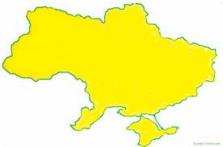
Inv. Request with CBCA decisions (Ele and Gas)
NO
FI
GAS Transmission
8.1.1
GAS Transmission - ACER
SE
8.2.2
LNG
LNG Terminal
8.6
4.2.2
EE
5.2
LNG
4.4.1
4.2.1
UGS
GAS Underground Storage
UGS
8.2.4
IE
DK
LV
GAS Reverse Flow or Compressor Station
5.3 (part)
8.2.3
LT
UK
4.5.1
ELEC Transmission
8.5
ELEC Transmission - ACER
NL
BE
5.12
DE
PL
LU
5.10
6.1 (cluster)
6.2 (cluster)
CZ
UA
5.18
SK
FR
5.7
AT
6.13 (cluster)
HU
MD
SI
6.14
RO
IT
HR
7.1.5
(RO-HU sections)
BiH
RS
PT
ES
3.7.4
ME
KO
BG
Energy Community Contracting Parties
FYROM
AL
EL
CY
Note: the location of projects is approximate and for illustration

Slide 13
CBCA monitoring main findings
CBCA monitoring main findings
Approx. 75% of the investment requests refer to projects located in one MS
In most cases, 100% of the investment costs allocated
The national net impacts based on CBA are generally positive => in the majority of cases, NRAs allocated the costs only to those MS which are hosting the project (territorial principle)
Reasoning for allocating cost only to hosting countries:
  Lack of net negative impact in the hosting country
  Lack of significant net positive impact (less than 10% of the total net positive impacts) in each of the non-hosting Member States

Slide 14
Possible improvement of CBCA under Reg. 347/2013
Improvement of CBCA under R. 347
Improvement of CBA
  Trustable and comprehensive methodologies
  Use of robust and plausible scenarios
  Monetise to the extent possible: key to compare benefits and costs
  Serve as informative tool for decision-makers
Regional cooperation before submission of investment request
  Beneficial to reach consensual solutions and streamline decision-making process
  Early involvement of TSOs and NRAs of impacted countries
  Consider the willingness to pay to facilitate the development of projects
  Joint CBCA for groups/clusters of projects in the same region
High quality and complete investment requests
CBCA once done is done: decisions must be final not to cause risks/ uncertainties for projects

Slide 15
Thank you for your attention!
www.acer.europa.eu

